Slide 1
LCC Cookbook v1.1
A fast track to getting LCC to do something useful
Comments and suggested edits can be sent to: Mike.Muha@NordicSkiRacer.com

Slide 2
Intro
This cookbook provides examples of things you can do with LCC. The recipes are designed to getting things up and running quickly. It is not a tutorial in why LCC does what it does but allows you to get LCC doing something useful in a minimum of time.
These are only a small set of examples. There are so many different use cases for LCC that it would be impossible to show all the possible configurations. But this cookbook might give you some insight and help you come up to speed faster.
Each recipe is independent and does not depend on another recipe.
Assumptions:
You have bought and set up a “LCC Starter Kit”
You have JMRI running.
You have connected JMRI to your LCC network.
Notes:
Wire colors key:
Red and black are used for track feeders
Green is used for frog power feeders
Using Tower LCC and SMD-8 boards to control 16 turnouts using JMRI panels and no physical buttons

Slide 3
List of Recipes
Using a Tower LCC node to control up to 16 Tortoise switch machines with Tortoise Quik-Link boards, controlling the turnouts using a JMRI panel
Using a Tower LCC node with a SMD-8 daughter board to control up to 16 MP1/MP4 switch machines using a JMRI panel

Slide 4
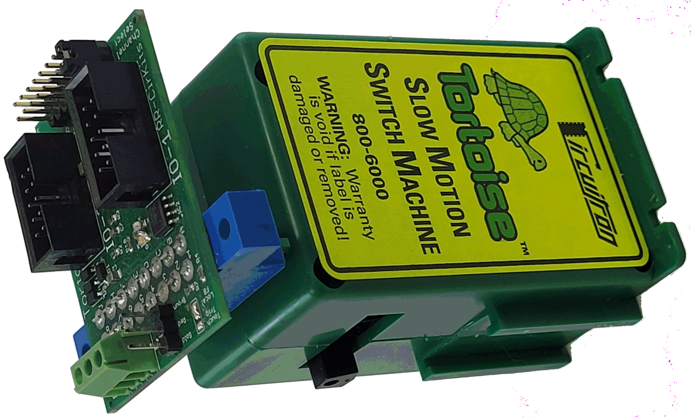
Recipe
Using a Tower LCC node to control up to 16 Tortoise switch machines using Tortoise Quik-Link boards and JMRI Panels
Tower LCC > Tortoise Quik-Link > Tortoise, via JMRI panels

Slide 5



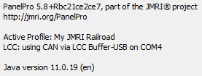
Ingredients
This recipe assumes you are ONLY using JMRI panels to control your turnouts. It also assumes you can create a JMRI panel.
Tower LCC versions:
JMRI / Java:
RR-CirKits Tower LCC node board
RR-CirKits Tortoise Quik-Link I/O board and driver
Circuitron Tortoise switch machine
10-pin Ribbon cable
Tower LCC > Tortoise Quik-Link > Tortoise, via JMRI panels

Slide 6
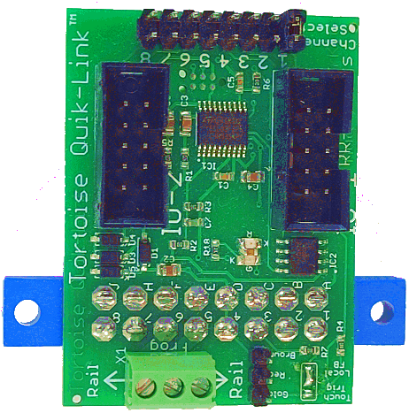

Powering the frog: Tortoise vs. Tortoise Quik-Link
Not all frogs need a wire for power (e.g., a power routing turnout such as Peco Electrofrog). Only add a frog power connection if your turnout supports it (e.g., has an isolated frog).
Powering a frog with direct connection to the Tortoise The frog lead is on pin 4, to the right of the two track leads.
Powering a frog with a Quik-Link The Tortoise Quick-Link has the Frog screw in the middle position, between the two track leads.
If you use black and red wires, you many need to swap them depending on the polarity of your track. Don’t just copy my diagram without thinking!
1
2
3
4
5
6
7
8
2
4
3
Tower LCC > Tortoise Quik-Link > Tortoise, via JMRI panels
Notes:
Tortoise pins:
DC power for tortoise motor
Red feeder from turnout
Black feeder from turnout
Green feeder from frog
Empty
Empty
Empty
DC power for tortoise motor

Slide 7
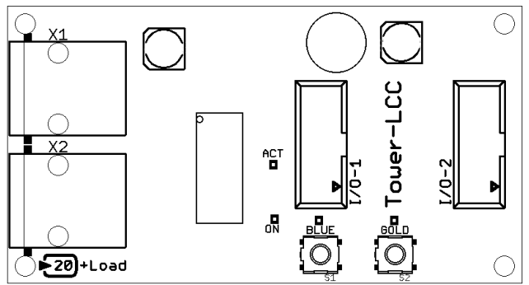
Connecting Tower LLC to Tortoise Quik-Link
The Tower LCC node can directly drive up to 16 Tortoise switch machines using the Tortoise Quik-Link board, 8 Quik-Links per I/O port on the node. The node also supplies 5V to drive the Tortoise motors. (The Quik-Link boards can only handle up to 5V).
Each Quik-Link must have a unique “channel”. The channels correspond to the Lines of the I/O connector that are carried by the ribbon cable. Use jumper 1 for the first Quik-Link, jumper 2 for the second, 3 for the third, 4 for the fourth …and jumper 8 for the final Quik-Link.
Tower LCC Board
Supports 8 or 16 Tortoise turnouts using Quik-Link
Tortoise 1 Quik-Link
Tortoise 2 Quik-Link
Tortoise 3 Quik-Link
Tortoise 4 Quik-Link
…and up to four more Quik-Link cards
10 pin Ribbon Cable
10 pin Ribbon Cable
10 pin Ribbon Cable
10 pin Ribbon Cable
10 pin Ribbon Cable
10 pin Ribbon Cable
Use the second I/O port for another 8 Tortoise turnouts on Quik-Links, or for a daughter board (SMD-8, BOD-4-CP, BOD-4, RB-2, SDB-4, etc.)
Tower LCC > Tortoise Quik-Link > Tortoise, via JMRI panels

Slide 8

Tower LCC Configuration: Hardware to software
The Tower LCC node has two I/O ports, each supporting 8 turnouts or other devices. When you go to
JMRI
> LCC menu
> Configure Nodes > Select “Tower LCC”
> Double-click “Open Configuration dialog”
> Segment: Port I/O
…you will see 16 “Lines”. Lines 1-8 represent the 8 turnouts controlled from the I/O-1 port on the Tower LCC node, and Lines 9-16 are controlled through the I/O-2 port:
In the example above, some on the lines have been given names that make them more user-friendly.
Tower LCC > Tortoise Quik-Link > Tortoise, via JMRI panels

Slide 9
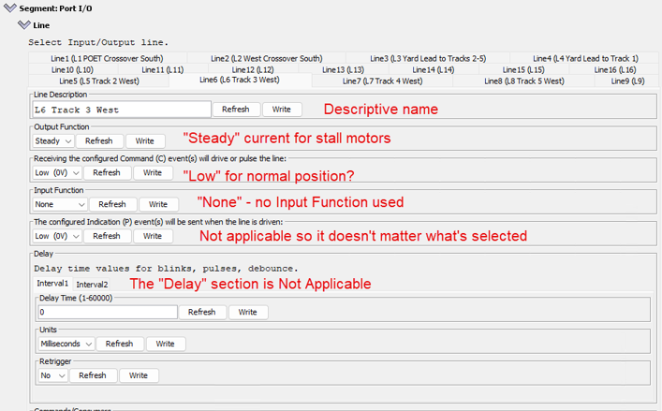
Tower LCC configuration
Each “Input/Output line” controls 1 turnout. 16 lines means you can control 16 turnouts. We’re going to configure Line 1, which goes to Tower LCC I/O 1, which goes to the Tortoise Quik-Link configured for channel 1.
Tower LCC > Tortoise Quik-Link > Tortoise, via JMRI panels

Slide 10
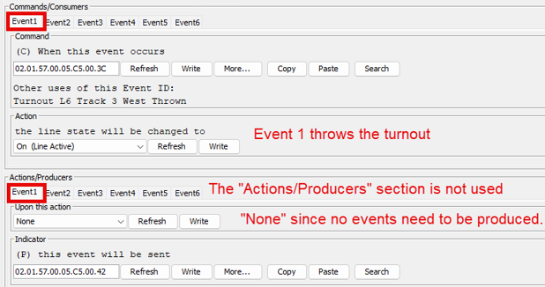
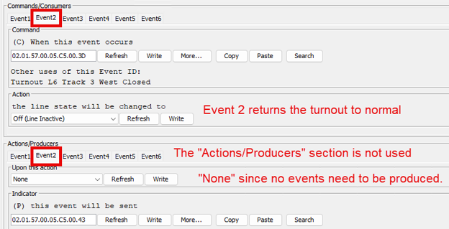
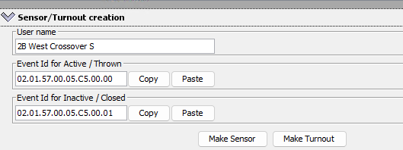
Add two events then copy IDs to Turnout creation
This last section lets you create a turnout in the JMR turnout table with the User Name you provide. In JMRI, you link the User Name to a turnout on the panel, and that allows JMRI to send instructions to the Tortoise Quik-Link.
Copy/paste event IDs
Tower LCC > Tortoise Quik-Link > Tortoise, via JMRI panels

Slide 11
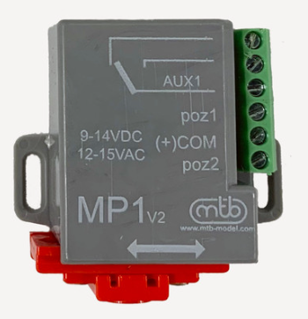
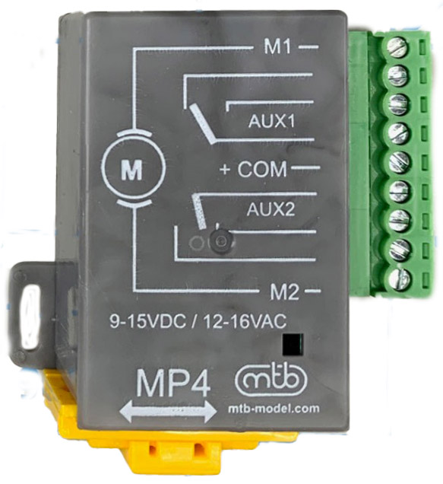
Recipe
Using a Tower LCC node with a SMD-8 daughter board to control up to 16 MP1/MP4 switch machines using a JMRI panel

Slide 12
Ingredients
This recipe assumes you are ONLY using JMRI panels to control your turnouts. It also assumes you can create a JMRI panel.
Tower LCC versions:
JMRI / Java:
RR-CirKits Tower LCC board
RR-CirKits SMD-8 Board
RR-CirKits BOB-S Breakout Board
RR-CirKits PS-S-15-1500 Power Adapter or other 12-15V DC power adapter (to power turnout motors).
Model Railroad Control Systems MP1 and/or MP4 switch machine
10-in Ribbon cable
AWG 22 or 24 wire (Cat5 twisted pair works!)
Using Tower LCC > SMD-8 boards > BOB-S breakout board to MP1/MP4, controlled using JMRI panels

Slide 13
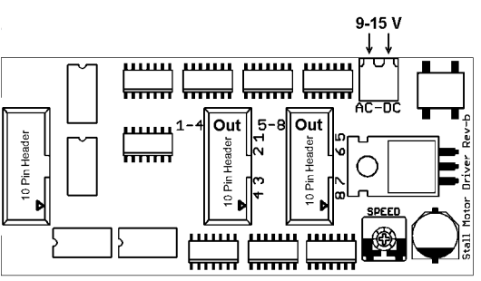
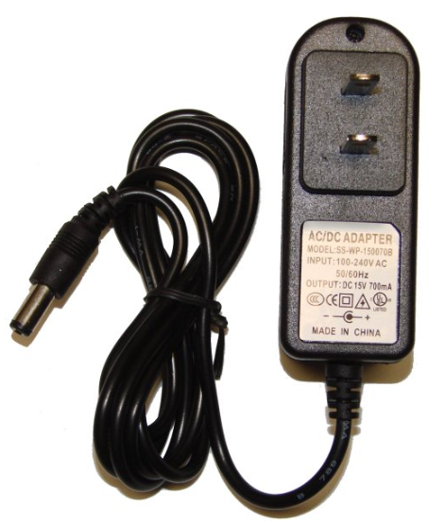
Using Tower LCC and SMD-8 boards for MP1 turnout machines
MP1, MP4, and MP5 switch machines require the SMD-8 (other other) I/O daughter boards. The daughter boards allow you to connect a 12V or 15V power adapter to supply power to a set of switch machines.
10 pin Ribbon Cable
White wire
Red wire
Tower LCC Board
Supports 8 or 16 turnouts. Use the bottom I/O port for a 2nd SMD-8 board.
SMD-8 Board
Supports 8 turnouts
PS-S-15-1500 Power Adapter
Cut the end off and insert into the two screw terminals.
The power adapter is used to power the turnout motors.
Using Tower LCC > SMD-8 boards > BOB-S breakout board to MP1/MP4, controlled using JMRI panels

Slide 14
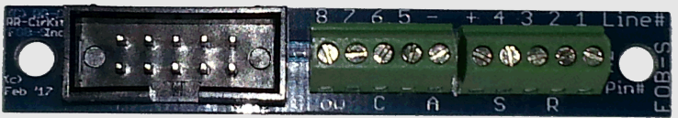
Connecting SMD-8 boards to Quik-Link or BOB-S
10 pin Ribbon Cable
10 pin Ribbon Cable
Break apart a ribbon cable or Cat-5/Cat6 cable pairs for these runs.
A wire from the “+” terminal daisy chains it’s way to the “(+)COM” terminal on each MP1.
Line#8
7
6
5
-
+
4
3
2
1
MP1 turnout 8
MP1 turnout 7
Daisy chain to MP1 (+)COM ports
MP1 turnout 6
MP1 turnout 5
BOB-S Break Out Board
Supports 4 turnouts
Tower LCC Board
Supports 8 or 16 turnouts
SMD-8 Board
Supports 8 turnouts
Using Tower LCC > SMD-8 boards > BOB-S breakout board to MP1/MP4, controlled using JMRI panels

Slide 15
BOB-S to MP1 Switch Motor wiring
Not all frogs need a wire for power (e.g., a power routing turnout such as Peco Electrofrog). Only add a frog power connection if your turnout supports it (e.g., has an isolated frog).
8
7
6
5
-
+
4
3
2
1
If you use black and red wires, you many need to swap them depending on the polarity of your track. Don’t just copy my diagram without thinking!
Using Tower LCC > SMD-8 boards > BOB-S breakout board to MP1/MP4, controlled using JMRI panels

Slide 16
BOB-S to MP4 Switch Motor wiring
Not all frogs need a wire for power (e.g., a power routing turnout such as Peco Electrofrog). Only add a frog power connection if your turnout supports it (e.g., has an isolated frog).
8
7
6
5
-
+
4
3
2
1
If you use black and red wires, you many need to swap them depending on the polarity of your track. Don’t just copy my diagram without thinking!
Using Tower LCC > SMD-8 boards > BOB-S breakout board to MP1/MP4, controlled using JMRI panels

Slide 17
Tower LCC configuration
Each “Input/Output line” controls 1 turnout. 16 lines means you can control 16 turnouts. We’re going to configure Line 1, which goes to Tower LCC I/O 1, which goes to a line 1 from the SMD-8 board’s first I/O connector.
Tower LCC > Tortoise Quik-Link > Tortoise, via JMRI panels

Slide 18
Add two events then copy IDs to Turnout creation
This last section lets you create a turnout in the JMR turnout table with the User Name you provide. In JMRI, you link the User Name to a turnout on the panel, and that allows JMRI to send instructions to the Tortoise Quik-Link.
Copy/paste event IDs
Tower LCC > Tortoise Quik-Link > Tortoise, via JMRI panels

